Slide 1
Kubernetes Storage
Prakash Ramchandran

Slide 2
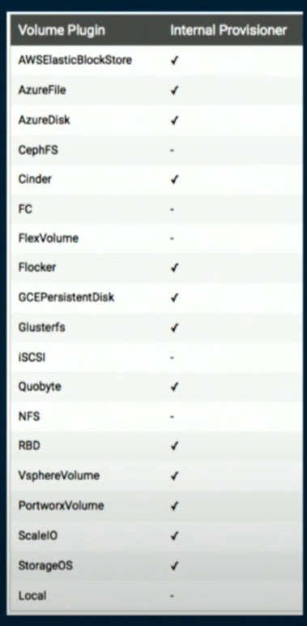
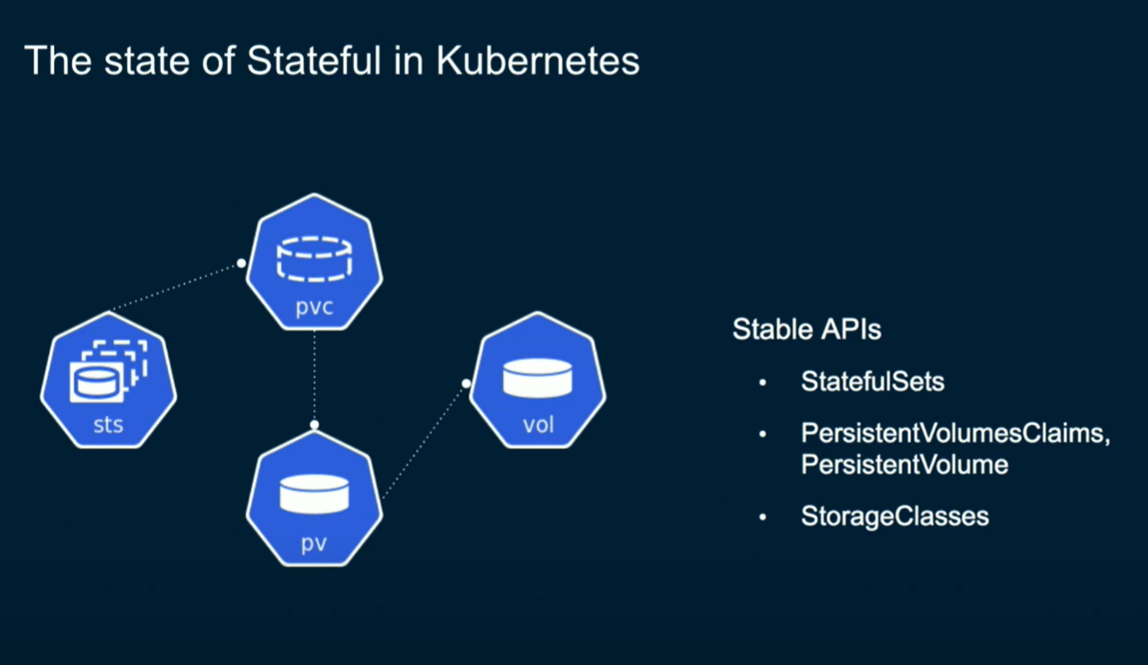
Supporting Multiple Storage Provisioners
https://github.com/kubernetes-sigs/sig-storage-lib-external-provisioner

Slide 3
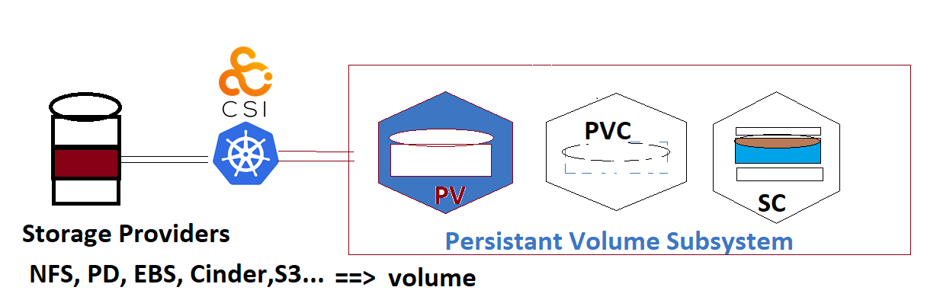
Storage & Containers
Imperatively created Singleton PoDs are mortal
and So are Containers
and hence any Storage Local to Containers along with other Resource Objects.
Declarative higher level controllers like Deployments & StatefullSets can be used to manage short or long living PoD’s/Container’s/Volume’s
If container represents the Run Time, volume represents storage in kubernetes. Any and All external Storage is a volume.
Kubernetes connects External Storage or backends as are called using
Persistent Volume (PV)
Persistent Volume Claim (PVC)
Storage Class (SC)

Slide 4
Process to add volume to kube Cluster
Assume Kubernetes cluster runs on a Google Cloud
Google offers a Persistent Disk PD named say my-gdrive of 10 GB
User can create a gke-pv.yaml as follows and use kubectl to create a PV
apiVersion: v1
kind: PersistentVolume
metadata:
name: pv1
spec:
accessModes:
- ReadWriteOnce
storageClassName: test
Capacity:
storage: 10Gi
persistantVolumeReclaimPolicy:
Retain
gcePersistentDisk
pdName: my-gdrive

Slide 5
Creating & viewing PV
$ kubectl apply –f gke-pv.yaml
Persistentvolme/pv1 created
Kubectl get pv pv1
Nm Cap Mode ReclmPolicy staus StorageClass
Pv1 10 Gi RWO Retain Available test
Now that we have ReadWriteOnce Storage available lets Claim it
Call this new file gke-pvc.yaml
apiVersion: v1
kind: PersistantVolumeClaim
metadata:
name: pvc1
accessMode: ReadWriteOnce
storageClassName: test
resources:
requests:
Storage: 10 Gi

Slide 6
Creating a PVC
Once validated that pv1 and pvc1 are consistent in the sense your ask is = or < than available for same access volume as provided, you can create a pvc1 and claim the volume pv1 and later mount it for use by the PoD/Conatiner
kubectl apply –f gke-pvc.yaml
Persistantvolumeclaim/pvc1 created
Kubectl get pvc pvc1
Nm Status me Cap Access Mode StorageClass
pvc1 Bound pv1 10 Gi RWO test
Now you can use this Sigleton a simple example or as Part of Deployment of StafullSet

Slide 7
Attaching/Detaching Volume to PoD
apiVersion: v1
kind: Pod
Metadata:
name: volpod
Spec:
volumes:
name: data
persistentVolumeClaim:
containers:
name: ubuntu-ctr
image: ubuntu-latest
command: /bin/bash
- “c”
- “sleep 60m”
voumeMounts:
- mountpath : /data
name: data

Slide 8
Implementing Storage Class
$kubectl appy –f volpod.yml
Pod/volpod created
$kubectl describe pod volpod
Implementing Storage Classes
1. Create your k8s cluster with a storage-backend
2. Ensure that plugin for storage back-end is available
3. Create Storage Class object
4. Create PVC object that references Storage Class by name
5. Deploy the Pod that uses volume based on the PVC
Note workflow does not include creating a PV. This is because StorageClass create PVs dynamically

Slide 9
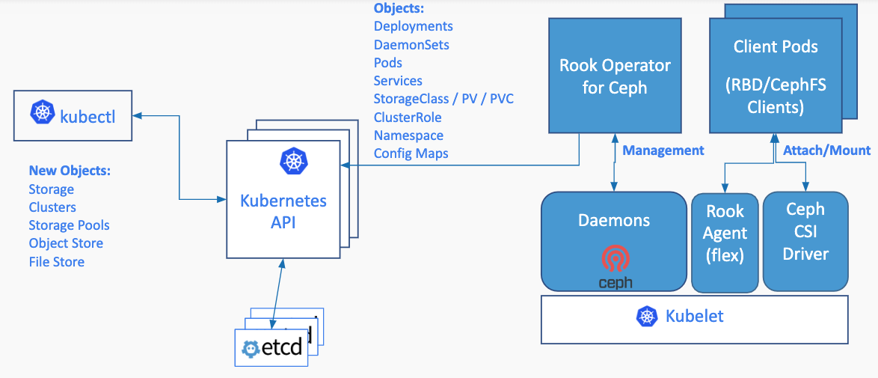
Rook : Production ready management for File, Block and Object Storage

Slide 10
Helm - The package manager for Kubernetes (Operators) v2/v3(secure)
https://helm.sh/blog/
Prerequisites
The following prerequisites are required for a successful and properly secured use of Helm.
A Kubernetes cluster
Deciding what security configurations to apply to your installation, if any
Installing and configuring Helm.
https://helm.sh/docs/intro/install/
Once you have Helm ready, you can add a chart repository. One popular starting location is the official Helm stable charts:
Helm Charts on officially moving to Arifactory (Jfrog)

Slide 11
References
CSI Specs : https://github.com/cncf-csi/specs
Rook : Cloud Native Storage - https://rook.io/
Helm - https://helm.sh/

